Slide 1
British Women’s Magazines
Objectives :
Develop understanding of changes in socio-historical impact.
Develop understanding in historical shifts in representing gender
Show understanding of dominant discourses and ideologies.
Develop evidence to support your argument in terms of covers, stories, editorials and understanding of historical shifts.

Slide 2
Key Terms
Mass audience v fractured/disjointed audience
Collective identity
Mediated identity
Patriarchal culture
Status quo
Dominant ideology
Passive v active audience
Hegemony
Coverlines/ideology/connotations/
representations/empowering /disempowering
/reductive/ liberating

Slide 3
Parody Stereotypes
Women know your limits

Slide 4
Content
The Ladies Home Journal in the 1950s quiz , ‘Making marriage work’ set women the task of
comparing themselves to a subjugated female ‘ideal’. Questions included , ‘Does your husband
grumble nastily when meals are unavoidably delayed?’ carried obvious implied messages. Wives
were not encouraged to divorce or seek counselling but to adopt a ‘less critical’ manner
suggesting female inadequacy as the root cause.
The first U.K Cosmopolitan (1972)has a ‘How Good A Lover Are You?’ quiz.
What is suggested by the change in content in the context of women’s roles in society?

Slide 5
Theory
1963 Betty Friedan ‘The Feminine Mystique’ attacked the image of ‘the happy h____________ heroine’,
encouraging women to serve the family rather than fulfil their potential.
Friedan shows that the editorial decisions concerning women's magazines were being mostly made by men,
who insisted on stories and articles that showed women as either happy housewives or unhappy, neurotic
C__________, thus creating the "feminine mystique"—the idea that women were naturally fulfilled by
devoting their lives to being housewives and mothers. Friedan notes that this is in contrast to the 1930s, at
which time women's magazines often featured confident and independent heroines, many of whom were
involved in careers
Discussing McCalls Magazine she writes, ‘the image of woman that emerges from this big pretty magazine is
young and frivolous,almost childlike; fluffy and feminine;p________; gaily content in a world of bedroom and
K__________, sex, babies and home. The magazine surely does not leave out sex; the only goal a woman is
permitted is the pursuit of a man. It is crammed full of food, clothing, cosmetics, furniture, and the physical
bodies of young women, but where is the world of thoughts and ideas, the life of the mind and the spirit?’
She also comments that these magazines contained a ‘”warning that c__________ and higher education were
leading to the “masculisation of women with enormously dangerous consequences to the home, the children
dependent on it and to the ability of the woman, as well as her husband to obtain sexual gratification.’ “

Slide 6
Marxist Theory
Noam Chomsky : (Manufacturing Consent)
‘ The mass media serves as a system for transmitting messages to the general populace. It is their function to amuse, entertain and inform, and to inculcate individuals with the values and beliefs and codes of behaviour that will integrate them to the institutional structures of the larger society. Hegemony is a representational strategy of power; it involves the use of representations to control people (to manufacture the consent of the ruled to the rule of the rulers).’
Cultural hegemony is the term used by the Marxist philosopher Antonio Gramsci. It states that a culturally diverse society can be ruled by one dominant class which imposes its own ideology on others. This dominant group’s ideology then comes to be seen as the norm and the only valid ideology thereby maintaining its control of power and the status quo.
Cultural hegemony imposes/ maintains the status quo. Through cultural hegemony women are / have been encouraged to remain passive and subordinate.

Slide 7
Pre 2nd wave
Analyse the following covers. Consider and explain the dominant ideology relating to
gender roles in society. Support your argument with reference to the cover models
(dress, actions, shot composition), cover lines and indications of content, connotations
of titles of the magazines and any changes relating to socio-historical context (e,g the
1944 issue).
Make Notes / spidergram on the ideologies presented by this range of magazines.

Slide 8
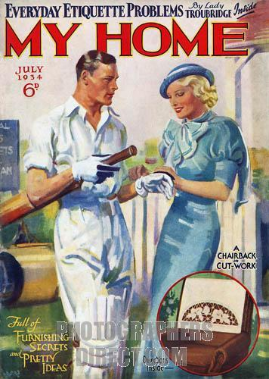
Implications of coverlines
Dominant Discourse
CoverLines
Actions
Title connotations / idelogical implications
Gender roles
Clothing
Costume
Language

Slide 9
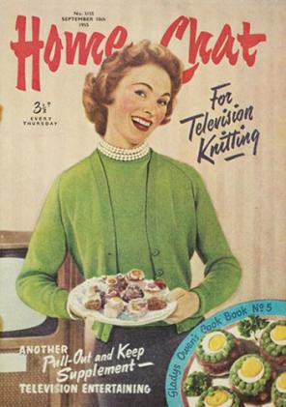
1944

Slide 10
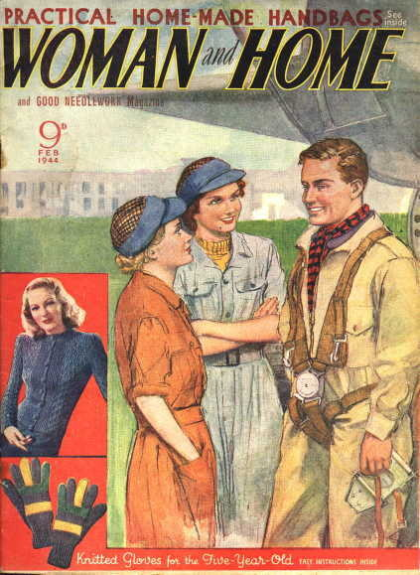
1944

Slide 11
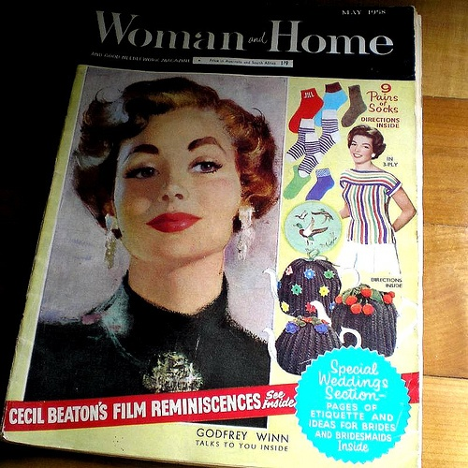

Slide 12
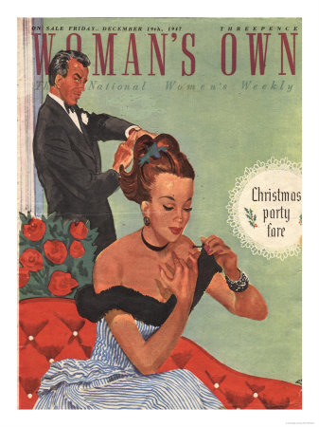

Slide 13
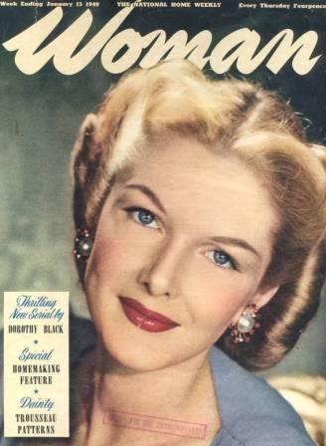

Slide 14
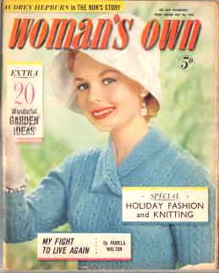
1959

Slide 15
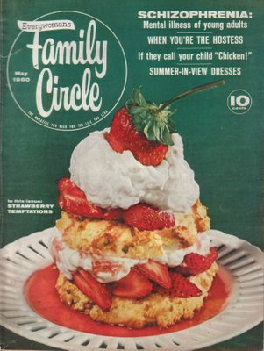

Slide 16
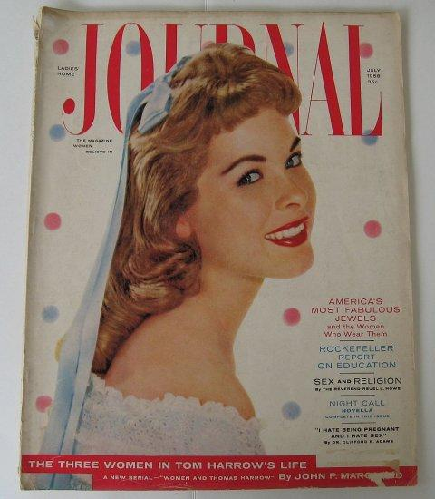
1958 / US

Slide 17
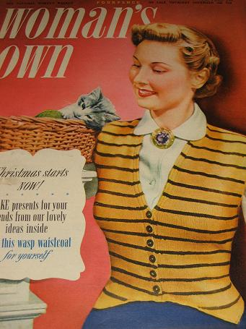
1950

Slide 18
Assessment
From your analyses of various women’s
magazines’ covers and contents what is
suggested about representations of women in
the 30s/40s/ and 50s? Bring in the theories of
Gramsci/ Chomsky and Friedan.
(patriarchal/ submissive / stereotypes/ reductive
/ decorative / passive/ dominant discourse/
status quo)

Slide 19
Women’s Magazines Part 2
Nova magazine was published in Britain from 1965-1975. It employed cutting edge writers, designers and editors, and its coverage of current events and social change set against striking visual design and innovative fashion pages challenged the idea of what a woman's magazine 'should' be.
1970 Miss World Contest was disrupted by feminist agitators/ activists. (see Youtube)

Slide 20
Applying Theory
What would Gramsci / Foucault make of the magazines you have looked at?

Slide 21
2nd Wave Feminism
One project of second wave feminism was to create ‘positive’ images of women, to act as a counterweight to the dominant images circulating in popular culture and to raise women’s consciousness of their oppressions

Slide 23
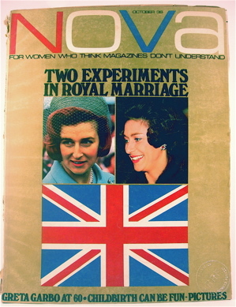
1965

Slide 24
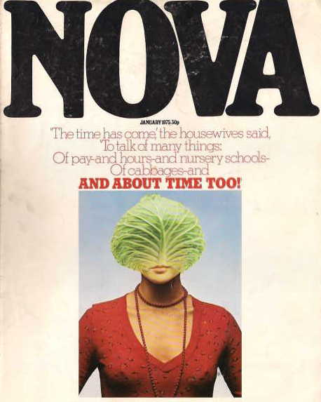
1975

Slide 25

1980s

Slide 26
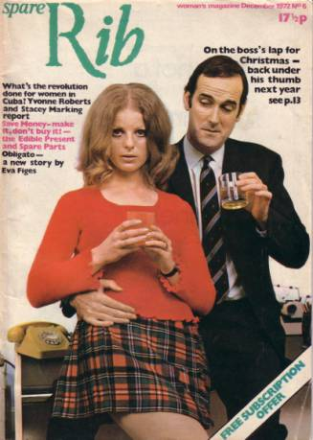
1972
(Same year as UK Cosmo

Slide 27
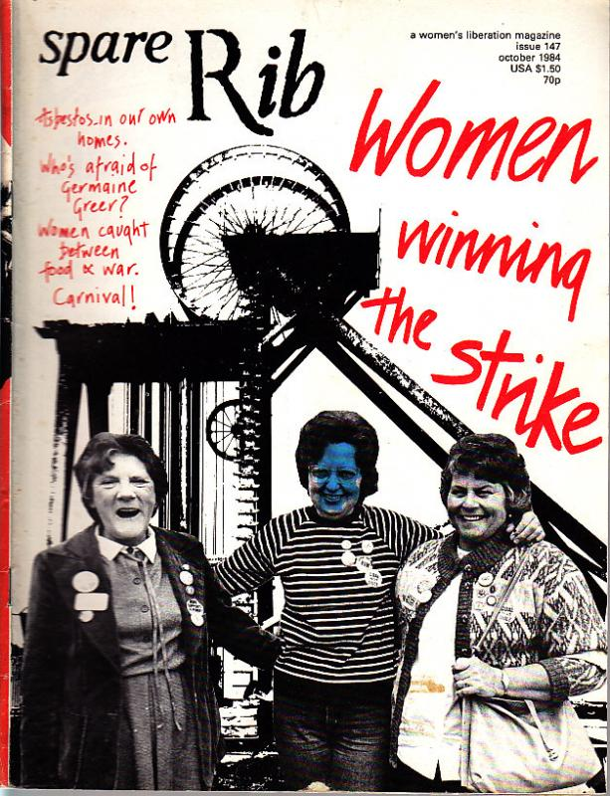

Slide 28
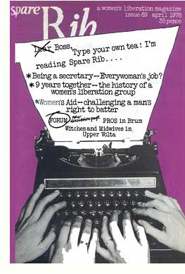

Slide 29
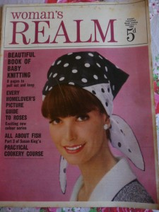

Slide 30
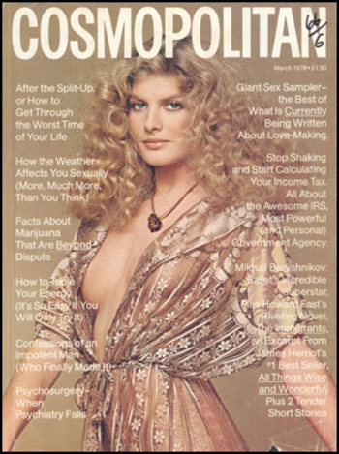
1978
Anna Faris
Youtube
Cosmo cover
Shoot
Look Closer-women’s magazine covers

Slide 31
Spare Rib -1972-
However, feminists have in hindsight commented on the reluctance of
the magazine to deal with one of the fundamental issues of Second Wave
feminism; that of the personal being political.
Two of the founders of ‘Spare Rib’, Marsha Rowe and Rose Ades, commented
on such problems in a talk given at the ‘Women and the Media’ conference in
Bristol in July1974, saying,
‘It was rushed into, so we were not at all sure what we were communicating, and produced a self-conscious, still underground, political hotch potch.[4]’
Despite such problems though, ‘Spare Rib’ provided a lifeline for many women for
whom it was sometimes the only means of contact with the Women’s Liberation
Movement and emerging feminist thought. However, its run was only 20,000 – 30,000
(and folded in 1993)per issue thereby suggesting it was of only limited appeal to a
mass audience who found the proto-feminist messages of Cosmopolitan with its
unashamed celebration of femininity more appealing. Of course, it also made
magazines like Spare Rib far less attractive to many advertisers and they refused to run
adverts in which women were objectified. An editorial claim. ‘We are confronting the media image of women’s liberation, of bra-burning and test tube babies, on its own ground. We are fighting the media with media of our own.’

Slide 32
Style in Spare Rib
Many of the founders of ‘Spare Rib’ such as Marsha Rowe and Rosie Boycott were formerly involved in the underground press of the 60s that had experienced great success with the advent of liberal movements. This was reflected in the look and style of the magazine which shunned the glossy style of women’s publications such as ‘Cosmopolitan’ in favour of a look that imitated the bold, simple style of the newsletters of the 60s underground press.
Its purpose, as set out in its editorial was to investigate and present alternatives to the traditional gender roles for women of virgin, wife or mother. Its early publications were linked closely with political theories of the time. In particular anti-capitalism was linked to women’s issues via the cosmetic industry’s exploitation of women’s insecurities and the pressure on them to be beauty-conscious. It also carried articles criticising the advertising industry and its encouragement of a materialistic consumer-culture. An early issue of the magazine for example contains an article criticising the attempts of kitchen firms to persuade women to perpetually update their homes. It states,
‘There is no such thing as an innocent design. In the drive to sell, design is used to convince consumers that products are continually new and improved.[3]’
Content included critiques of the advertising and cosmetics industry which exacerbated female anxiety by propogating outdated decorative stereotypes.

Slide 33
Assessment
In what ways are Nova, Working Woman and
Spare Rib different to other magazines you have
studied in terms of style and content and what
are the implications of this?
What problems did these magazines face and
how successful were they in overcoming them
and why?

Slide 34
Continuing Changes
Woman's Realm fails to find recipe for its survival
By Tom Leonard, Media Correspondent
Published: 12:00AM BST 19 Apr 2001
THE weekly magazine Woman's Realm, which has treated generations of readers to knitting patterns and 20 quick recipes for chicken, is folding after its publisher judged it was out of touch with modern women.
'Dowdy image': the magazine is to be merged with its sister publication, Woman's Weekly The title, which was launched in 1958, still has sales of 152,000 but has failed to shake off its "dowdy image", IPC said yesterday. It will be merged with its sister publication, Woman's Weekly, while IPC hopes to attract its more upmarket readers to a new magazine, Your Life.
The company believes the new title - whose first issue includes articles on designer shoes and women terrorists as well as exotic travel, "decadent" lifestyles and fashion - is more representative of the lives of women in their late thirties and forties.
Mary Frances, the editor of both Woman's Realm and Your Life, said that research for IPC showed that Woman's Realm's content no longer reflected the financially independent lives of its target readership. The research suggests that such women do not necessarily believe that marriage is for life and that a high percentage will have tried illegal drugs.
She said: "We tried to change the magazine but it is still associated with knitting, even though we haven't carried patterns for six years. The lives of women in their forties and fifties are quite different to their mother's generation or even to 10 years ago.
"We've got women like Madonna, Sharon Stone and Lulu in their forties now. Women are more confident now. They were the first generation to take the Pill and go to pop festivals. These are women who have been at the vanguard of social change and refuse to think middle-aged."
While the staple diet of Women's Realm has been subjects such as health and decorating advice, IPC's research suggests that the current generation of readers are more interested in indulging themselves. With their children having left home, the so-called "empty nesters" have the time and money for such luxuries as Christmas shopping trips to New York and buying a second car

Slide 35
Assessment
1. Analyse the first set of covers. Consider and explain the dominant ideology relating to gender roles in society. Support your
argument with reference to the cover models (dress, actions, shot composition), cover lines and indications of content,
connotations of titles of the magazines and any changes relating to socio-historical context (e,g the 1944 issue).
2. In what ways are Nova, Working Woman and Spare Rib different to other magazines you have studied in terms of style and
content and what are the implications of this? What problems did these magazines face and how successful were they in
overcoming them and why?
3. What is significant about the success of recent magazines such as Glamour and Cosmopolitan and the demise of Magazines like
Spare Rib and Woman’s Realm in understanding the modern woman?

