Slide 1
Macbeth Revision

Slide 2
Quiz
Macbeth is initially Thane of ………
King …….. Rewards him by making him Thane of C……..
The three witches reveal the future to Macbeth and ……….
His wife fears he is too full of……..
When Duncan arrives he has second thoughts saying we will p……. n. f………..
She convinces him by saying she would rather dash their b………..’s brains out than go back on her word
After killing the king he cannot return the ………
……….. Flees to England
Macbeth becomes paranoid killing ………… and ………………’s family
Lady Macbeth becomes depressed and filled with regret saying ‘ O…. D….. S….. while she sleepwalks

Slide 3
Speed responses
Macbeth is not what he seems because……
Lady Macbeth is not what she seems because…
Banquo is a good soldier because…..
Duncan is a good king because….
Macbeth is weak because……
Macbeth is strong because…..

Slide 4
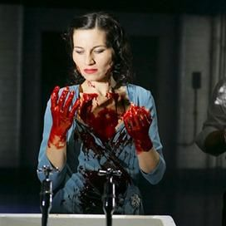
Page 174 . Explore the idea that Lady Macbeth gradually loses control of herself and her relationships.
How would you compare her behaviour to previous scenes?
What do her actions suggest?
Who or what is she referring to and what is its relevance?
Planning
At the beginning of the play Lady Macbeth seems very confident and controlled because…..
She is particularly in control when….
This is especially emphasised because Macbeth has less control when …
Problems begin to appear later when she ………
She is under more strain when…….
Finally we understand what she is really like when she….
This suggests that her real personality was……

Slide 5
